Slide 1
pcn
Comprehensively manage the PovcalNet files and folders

Slide 2
pcn
create
load
groupdata
download
master
primus

Slide 3
pcn
create
load
groupdata
download
master
primus
pcn subcommand , countries(3-letter code) year(####) options

Slide 4
pcn
create
load
groupdata
download
master
primus
Loads into memory the file corresponding to the parameters given by the user.
GPWG
Working Data (WRK)
CPI
pcn load [kind] , countries(3-letter code) year(####) options

Slide 5
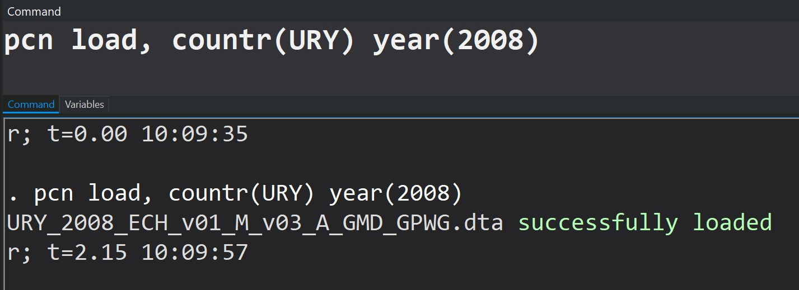
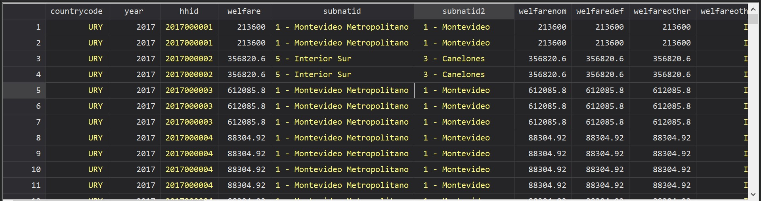
GPWG (default)
Working (WRK)
CPI
pcn
create
load
groupdata
download
master
primus
Loads: GPWG 2008 Uruguay Data

Slide 6
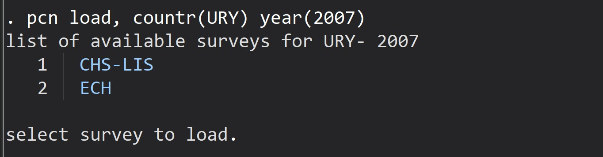
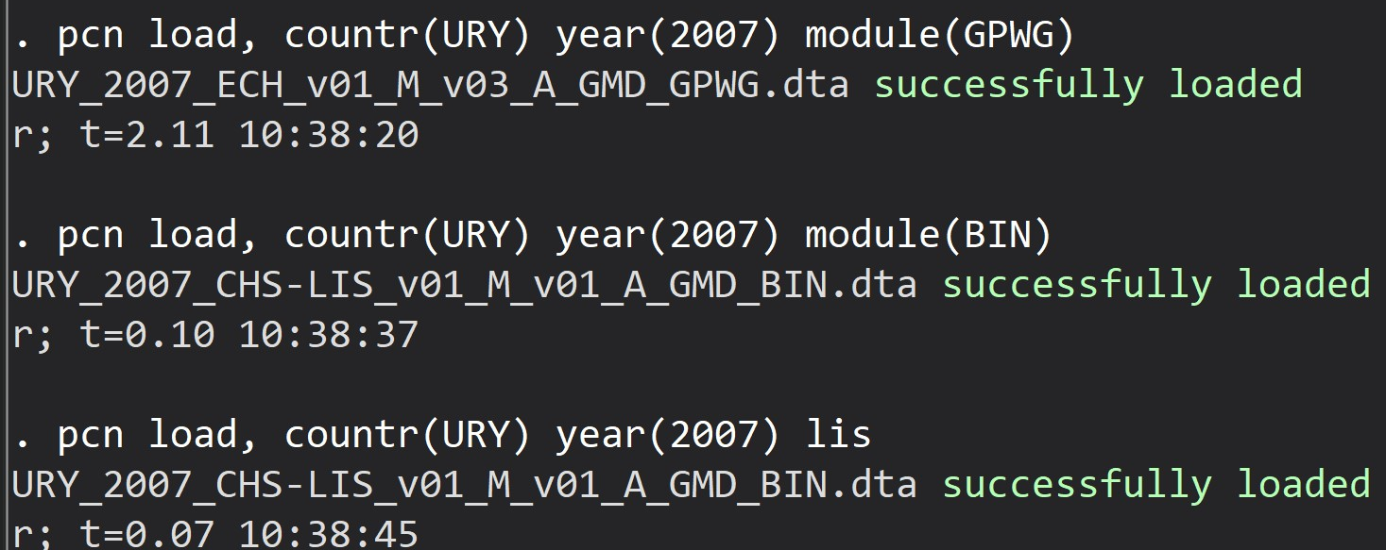
If more than one a list deploys
GPWG (default)
Working (WRK)
CPI
pcn
create
load
groupdata
download
master
primus
Avoid the list:
Module / lis options

Slide 7
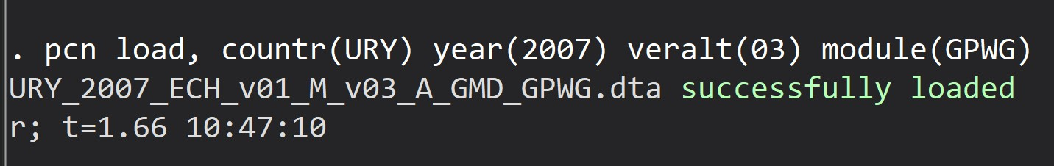
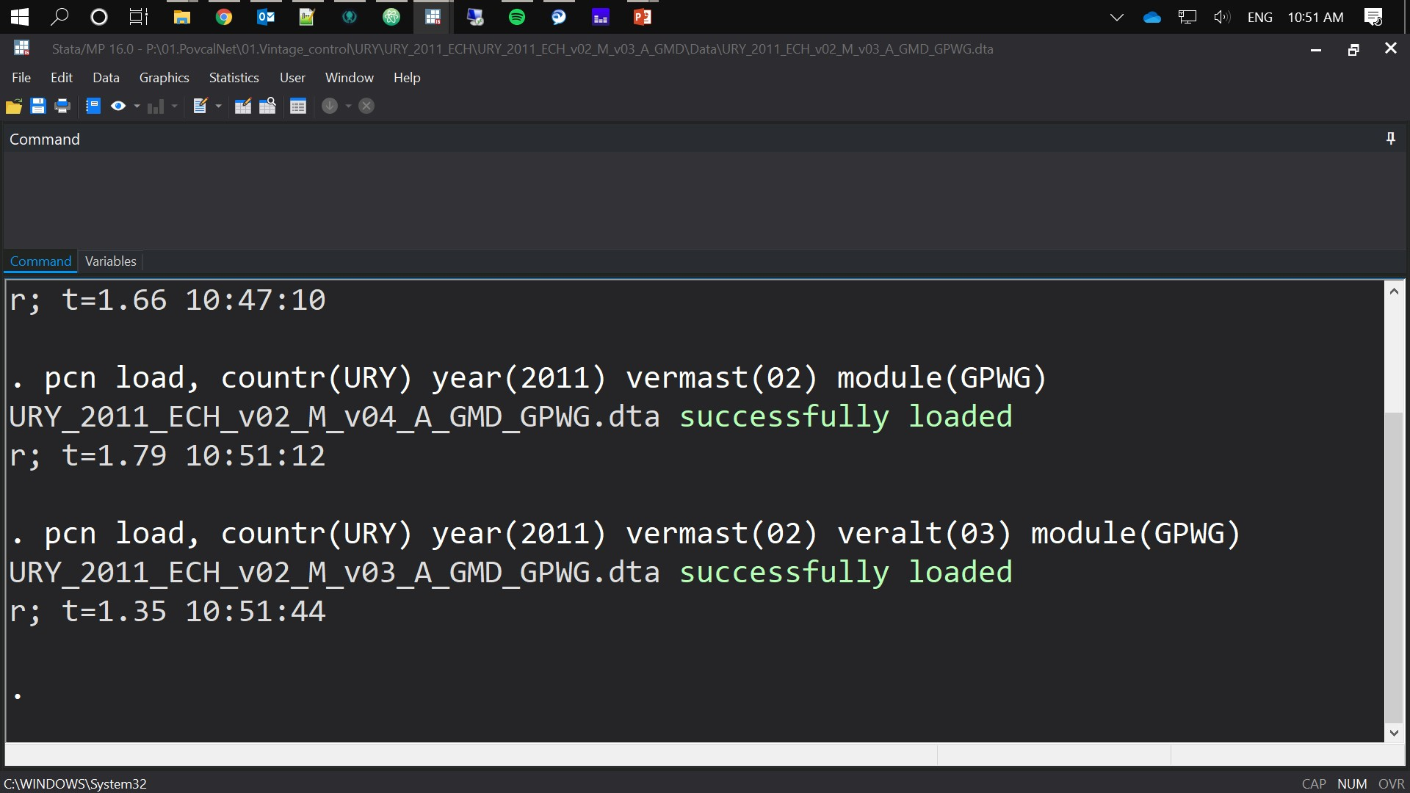
Replications Exercises:
GPWG (default)
Working (WRK)
CPI
pcn
create
load
groupdata
download
master
primus
Choosing an alternative version:
veralt(##) option
Choosing an alternative version:
vermast(##) option
vermast and veralt can be combined

Slide 8
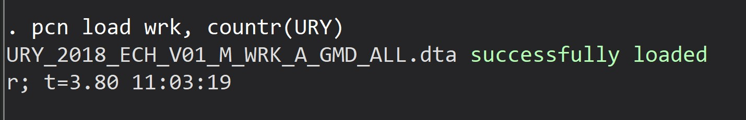
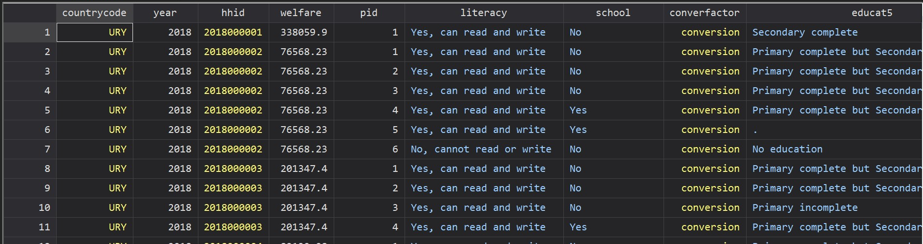
GPWG (default)
Working (WRK)
CPI
pcn
create
load
groupdata
download
master
primus
Loads: Working data for the latest year

Slide 9
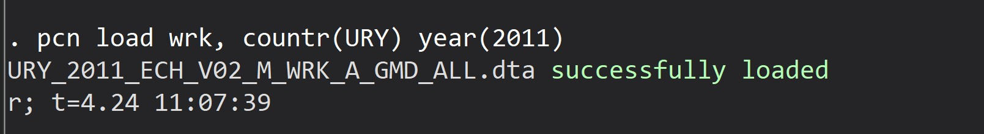
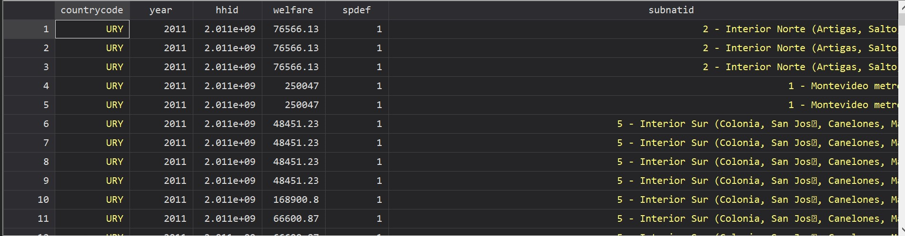
GPWG (default)
Working (WRK)
CPI
pcn
create
load
groupdata
download
master
primus
Loads: Working data for the given year

Slide 10

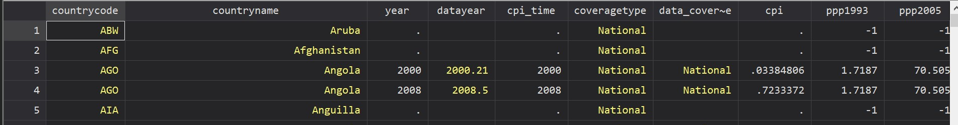
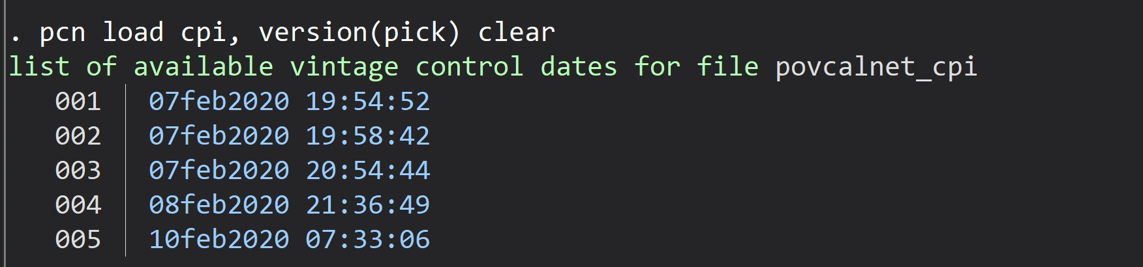
GPWG (default)
Working (WRK)
CPI
pcn
create
load
groupdata
download
master
primus
Loads: CPI data
Version option:

Slide 11
pcn
create
load
groupdata
download
master
primus
Loads or updates the master file.
pcn master , load(sheet) shape(long) version(pick\choose\select) options

Slide 12
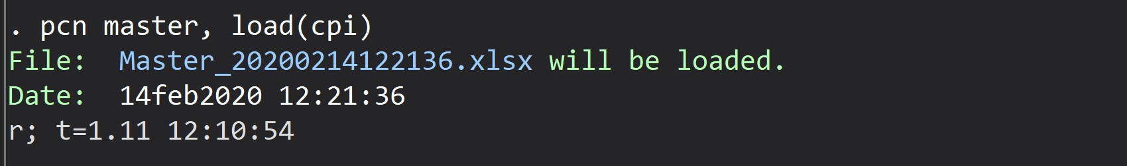
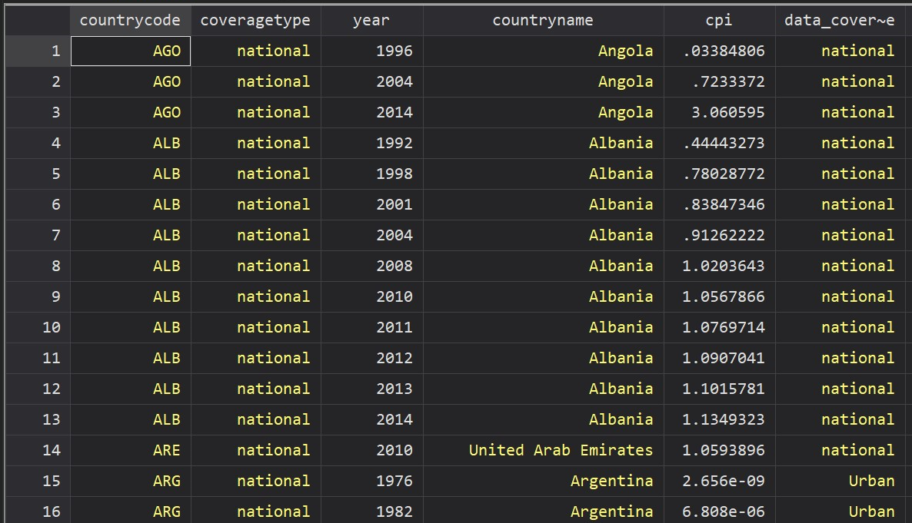
Update
Load
pcn
create
load
groupdata
download
master
primus
Loads: CPI data from the master

Slide 13
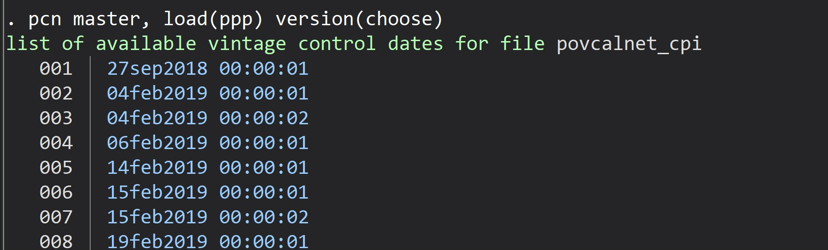
Update
Load
pcn
create
load
groupdata
download
master
primus
List the vintages to pick and load

Slide 14
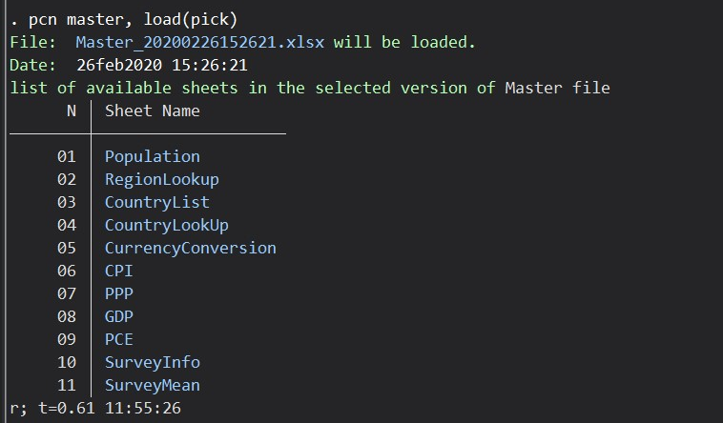
Update
Load
pcn
create
load
groupdata
download
master
primus
List the sheets to pick and load

Slide 15
pcn
create
load
groupdata
download
master
primus
This subcommand check for existing group data information and updates (or generates) the information.
pcn gd , options
pcn group , options
pcn groupdata , options

Slide 16

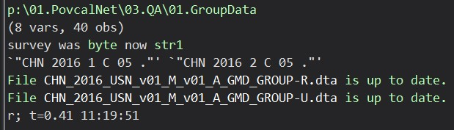
pcn
create
load
groupdata
download
master
primus
Check and creates Group Data

Slide 17
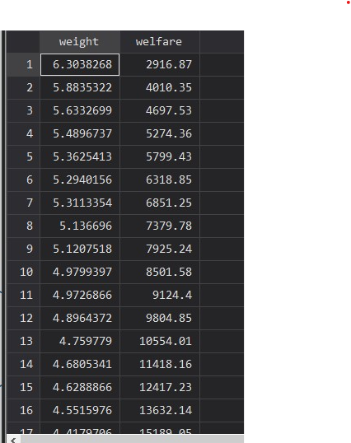
pcn
create
load
groupdata
download
master
primus
Ex. China Rural

Slide 18
pcn
create
load
groupdata
download
master
primus
Creates a dataset containing weights and welfare. (Relevant for PovcalNet tools.)
pcn create , countries(3-letter code) year(####) options

Slide 19

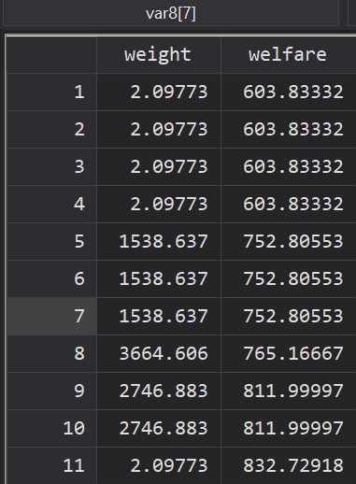
pcn
create
load
groupdata
download
master
primus
Creates txt file with weight and welfare for Denmark 2013 (also loads it)

Slide 20
pcn
create
load
groupdata
download
master
primus
Allows to manage with ease both the pending and approved data on PRIMUS.
approved
pending
pcn primus [approved | pending] , [ down(estimates|transactions) | load(estimates|transactions) ] options

Slide 21

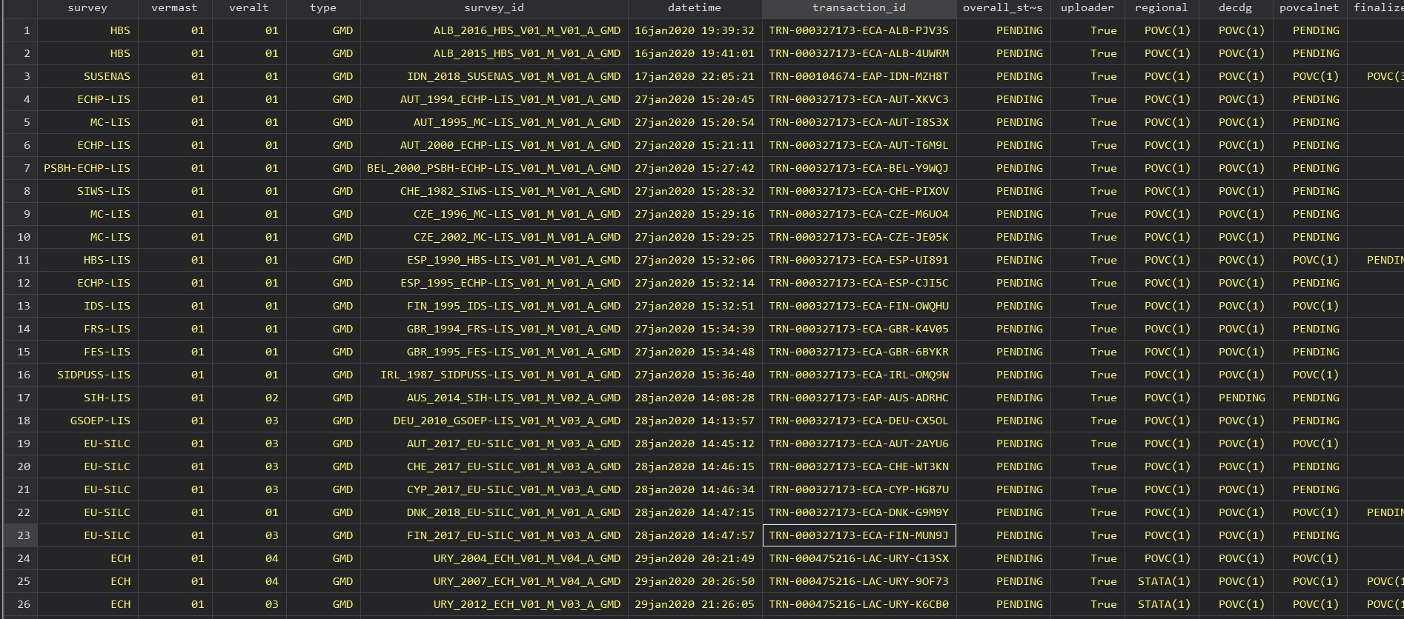
Load
down
pcn
create
load
groupdata
download
master
primus
Load the transactions information with pending status

Slide 22

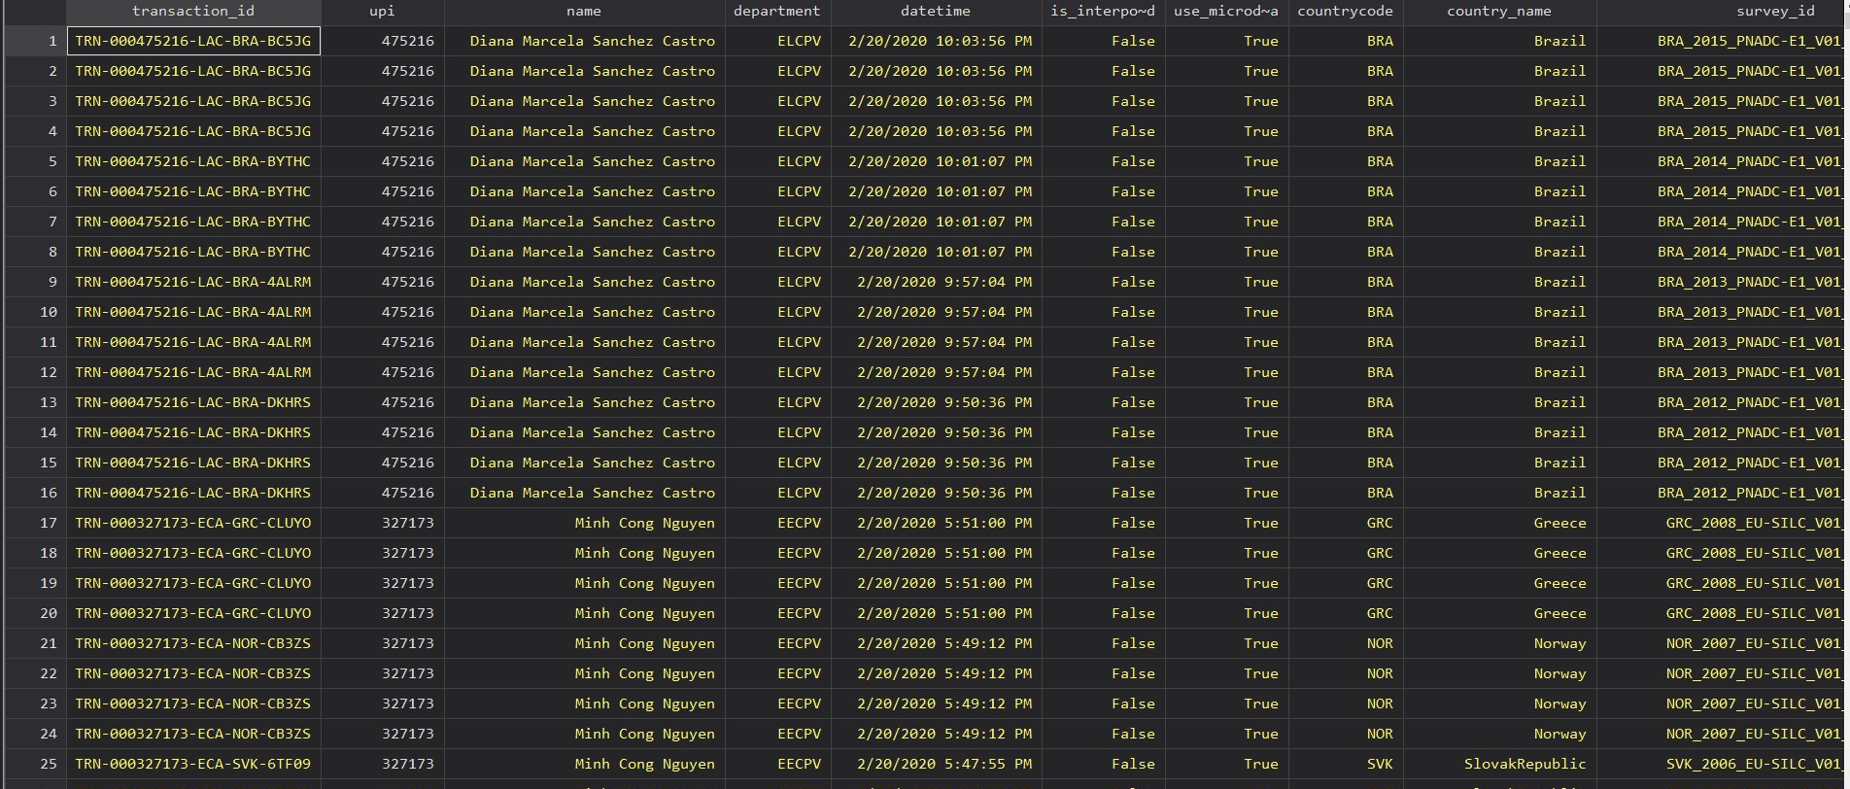
Load
down
pcn
create
load
groupdata
download
master
primus
Load the estimates information with approved status

Slide 23
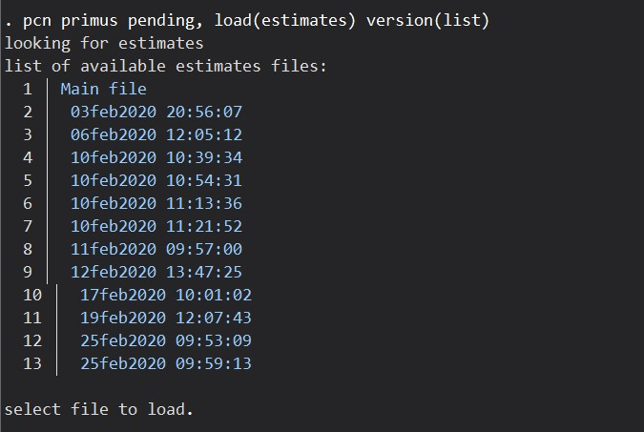
Load
down
The version option allows you to pick on a date basis:
pcn
create
load
groupdata
download
master
primus

Slide 24
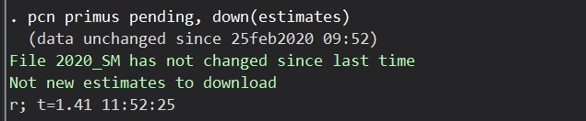
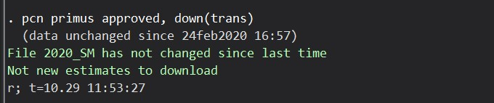
Load
down
pcn
create
load
groupdata
download
master
primus
Download the latest pending estimates:
Download the latest pending estimates:

Slide 25
pcn
create
load
groupdata
download
master
primus
(Rarely used). Downloads the latest file(s) available. Should be only used when major updates are released.
GPWG
Working
pcn download [kind] , countries(3-letter code) year(####) options

